Slide 1


To Unilife

Slide 2




Your mood before the lesson:

Slide 3



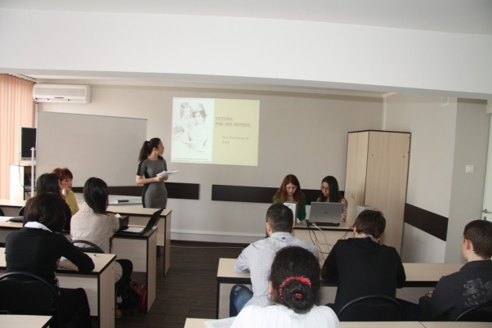

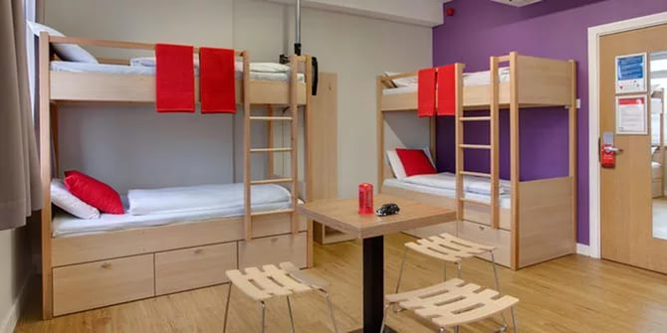

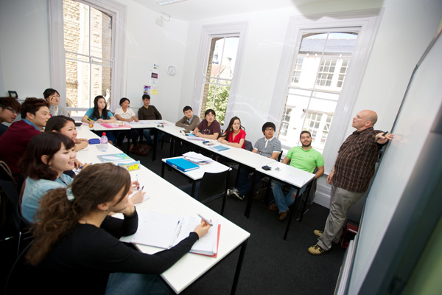
What do you expect to learn from this article?

Slide 4

Unilife
What are you going to be?
Do your parents agree with your choice?
Have you already chosen what higher educational institution to enter?
What factors are important for you when choosing a university to enter??

Slide 5





What university to enter?

Slide 6

Say, what the title of the lesson is?

Slide 7


Match the headings with the texts
a special dress code
a nighttime snack

Slide 8



Match the headings with the texts
getting involved in
organized activities
lack of money, self-study

Slide 9
What can you tell us about Oxford University?
Places | Lessons | Accommodation | Teachers | After-school activities
campus, Student Union, library, college dining hall | lectures, essay deadlines, private research, seminars, tutorial | halls, student house | tutor | university newspaper, drama club, canoeing club, parties, concerts, hanging out, formal dinners, social life, band, theme night

Slide 10




Your mood after the lesson:

